Slide 1
Winform Application
A slideshow on,
the Code generation for Winform App
Changing variables from generated code
Creating Custom Objects without toolBox
Debugging and problem solving

Slide 2
What is Code Generation
How does code generation work?
(concept)
Can we do anything about it?
What the heck is the partial keyword?

Slide 3
What is the fancy partial word
What is a class? =>(you guys answer)
What is a class member? =>(you guys answer)
What is a Object => (you guys answer)
What is NameSpace => (I probably answer) (also next slide if no one knows)
What (partial) is => next slide

Slide 4
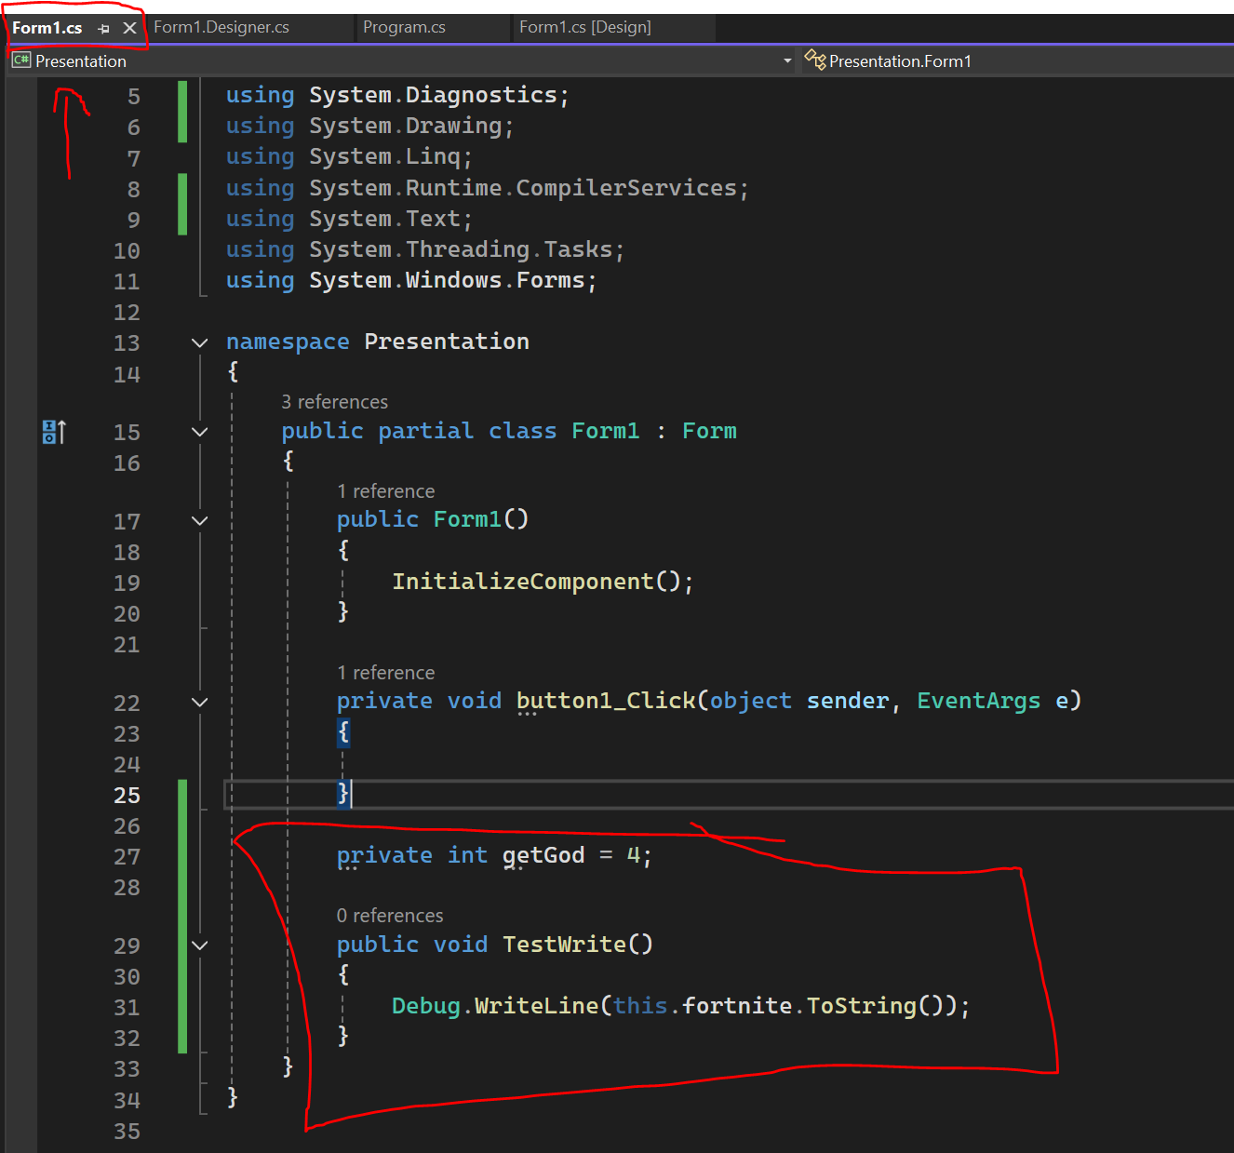
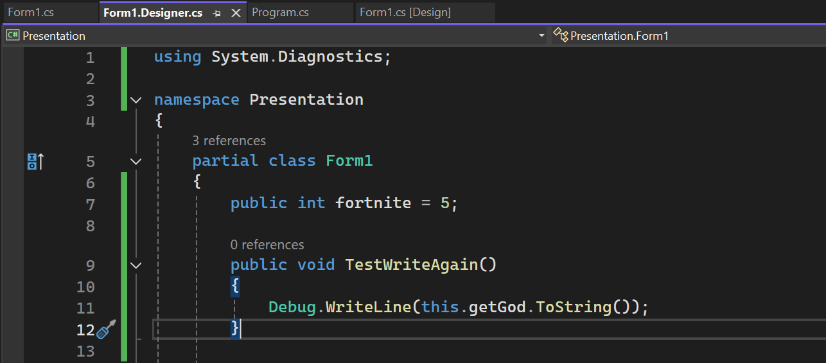
Partial Keyword
Allows declaration of class members over multiple files
Merges as compile time Ex: of using this
Conflicts with with same function names if
Not different arguments

Slide 5
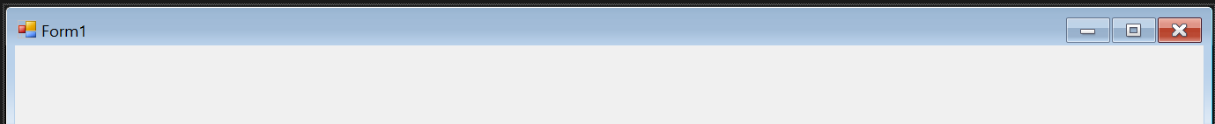
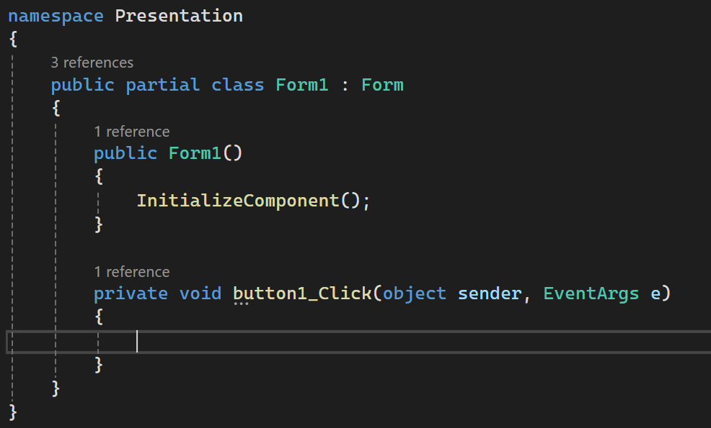
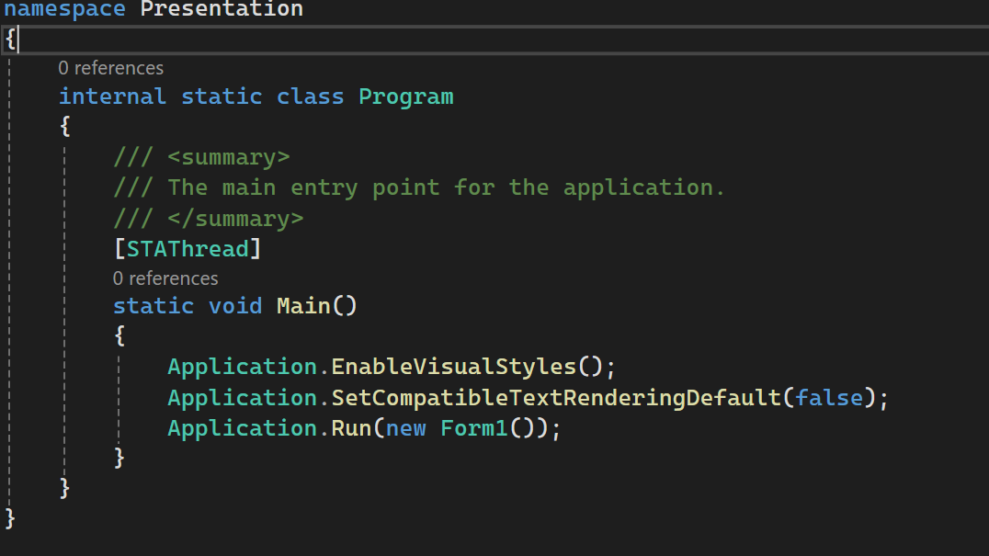
Yes it’s a programming language
Example of editing from code rather than UI
(you’re a software engineer) =>how would we go about changing the name
Form1.cs[design] ^^^
<==Form1.cs

Slide 6
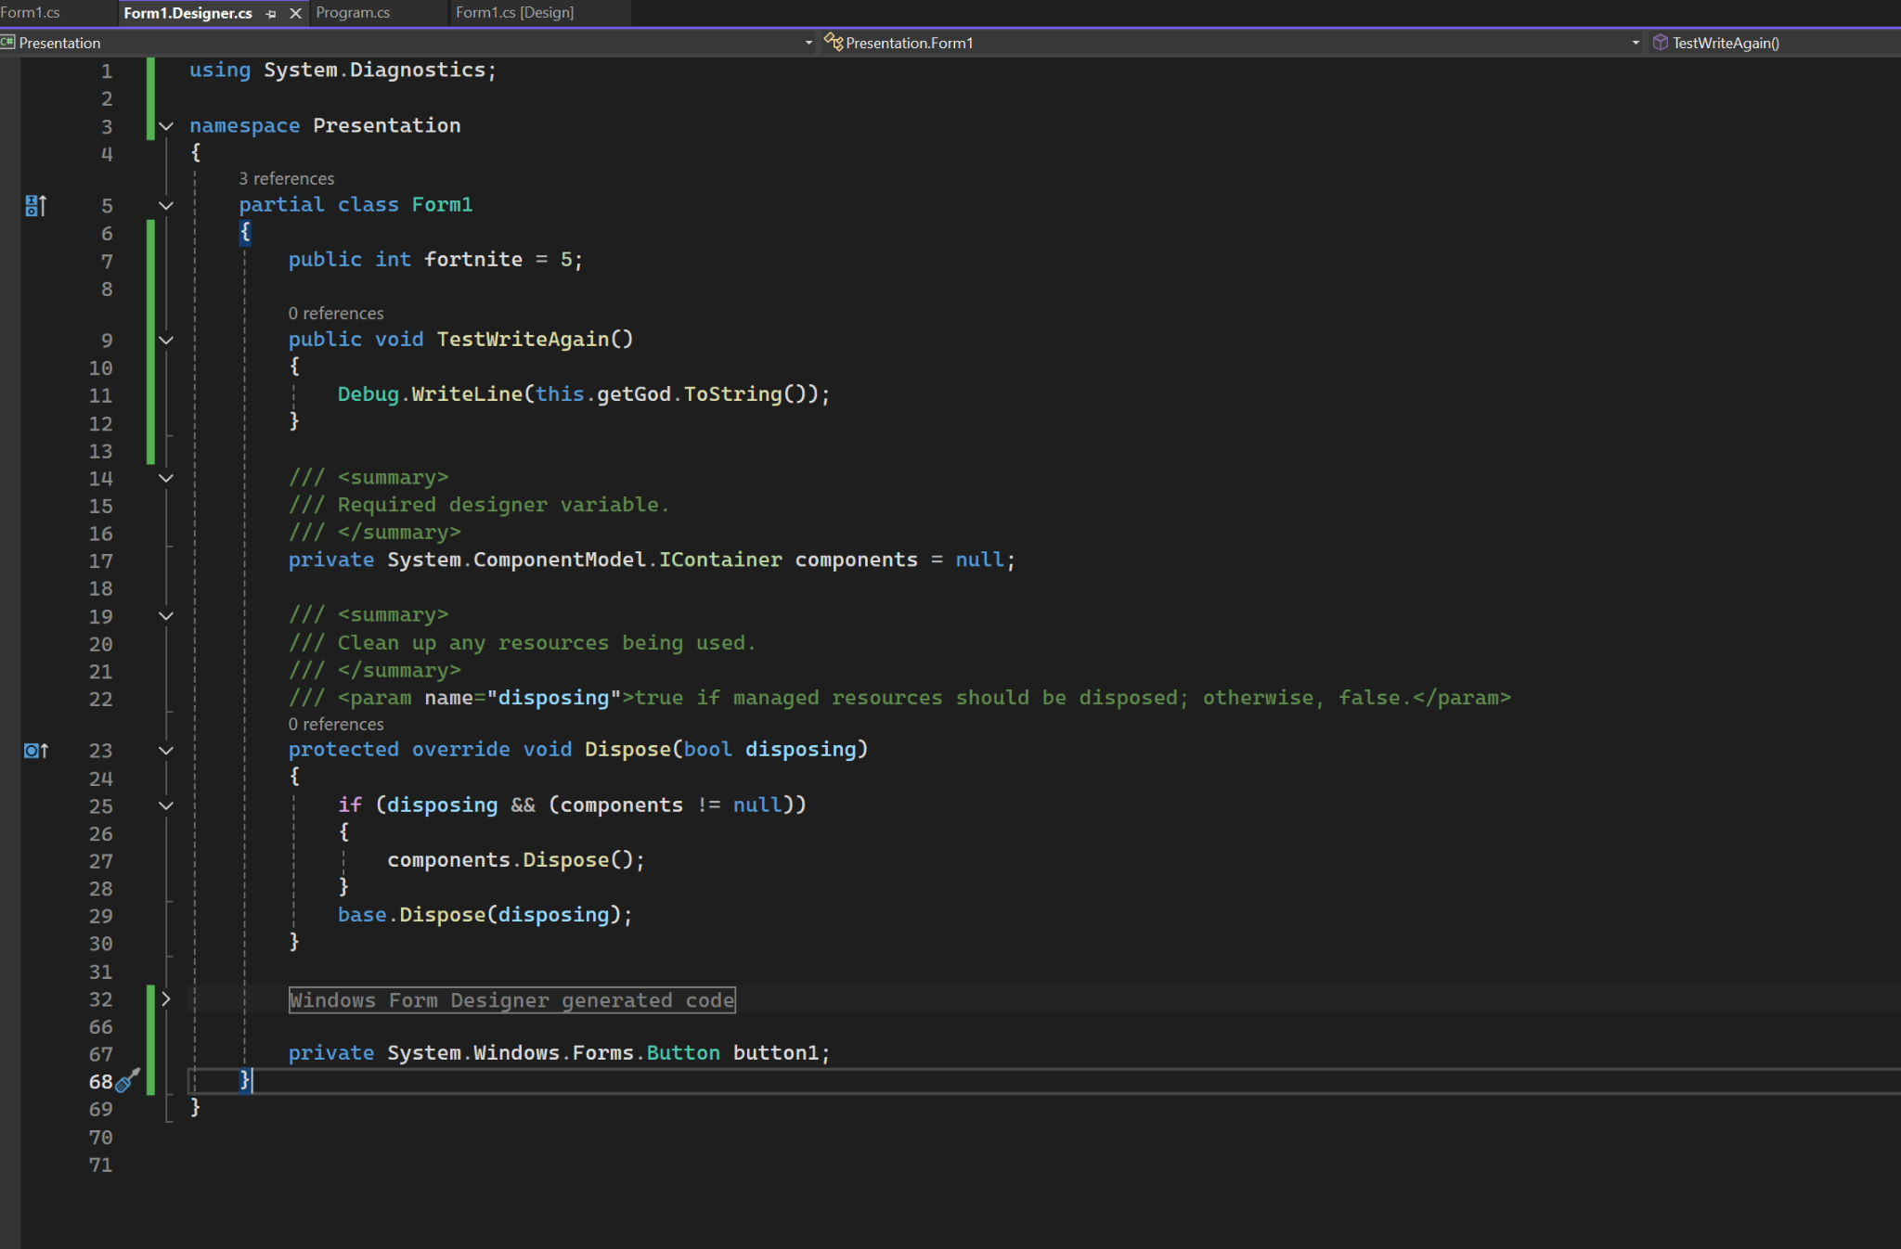

Slide 7
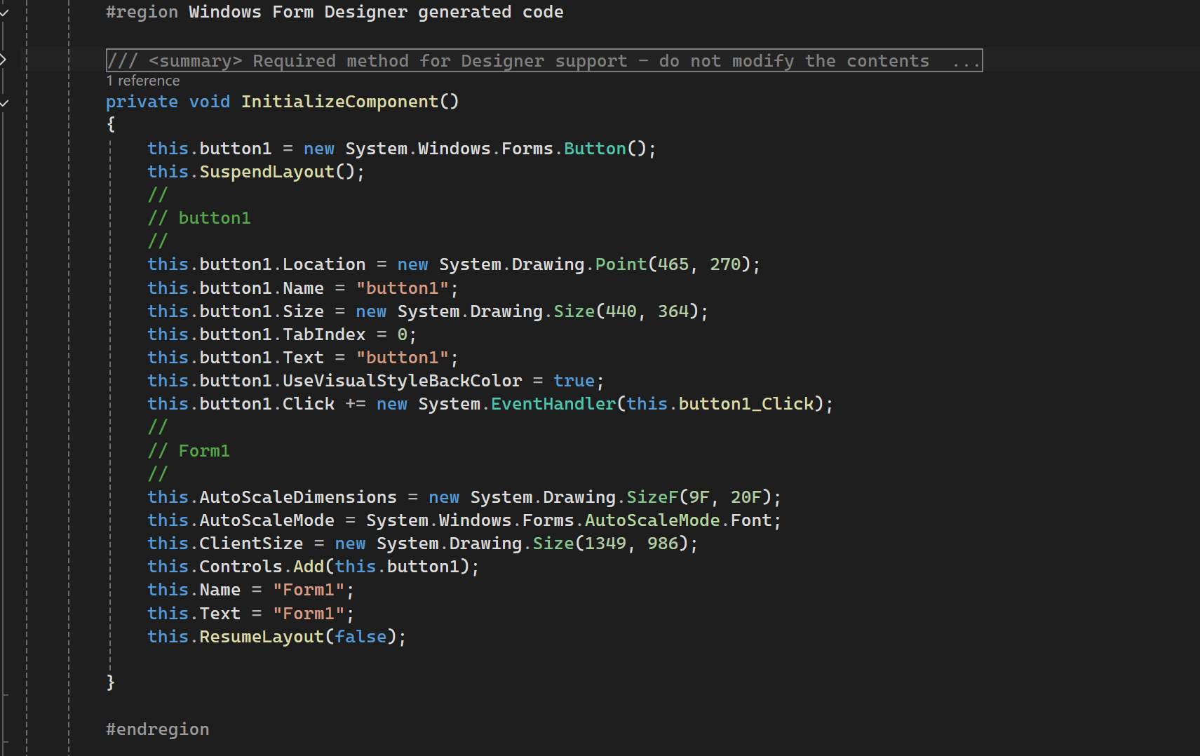

Slide 8
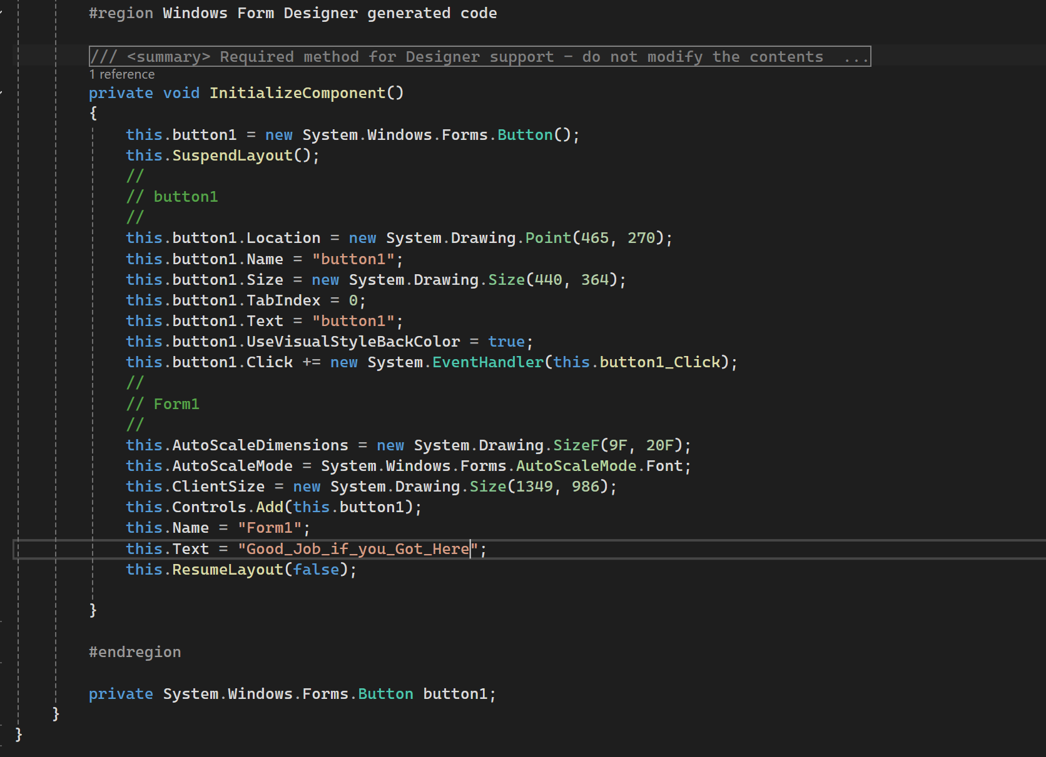
This is a secret for later

Slide 9
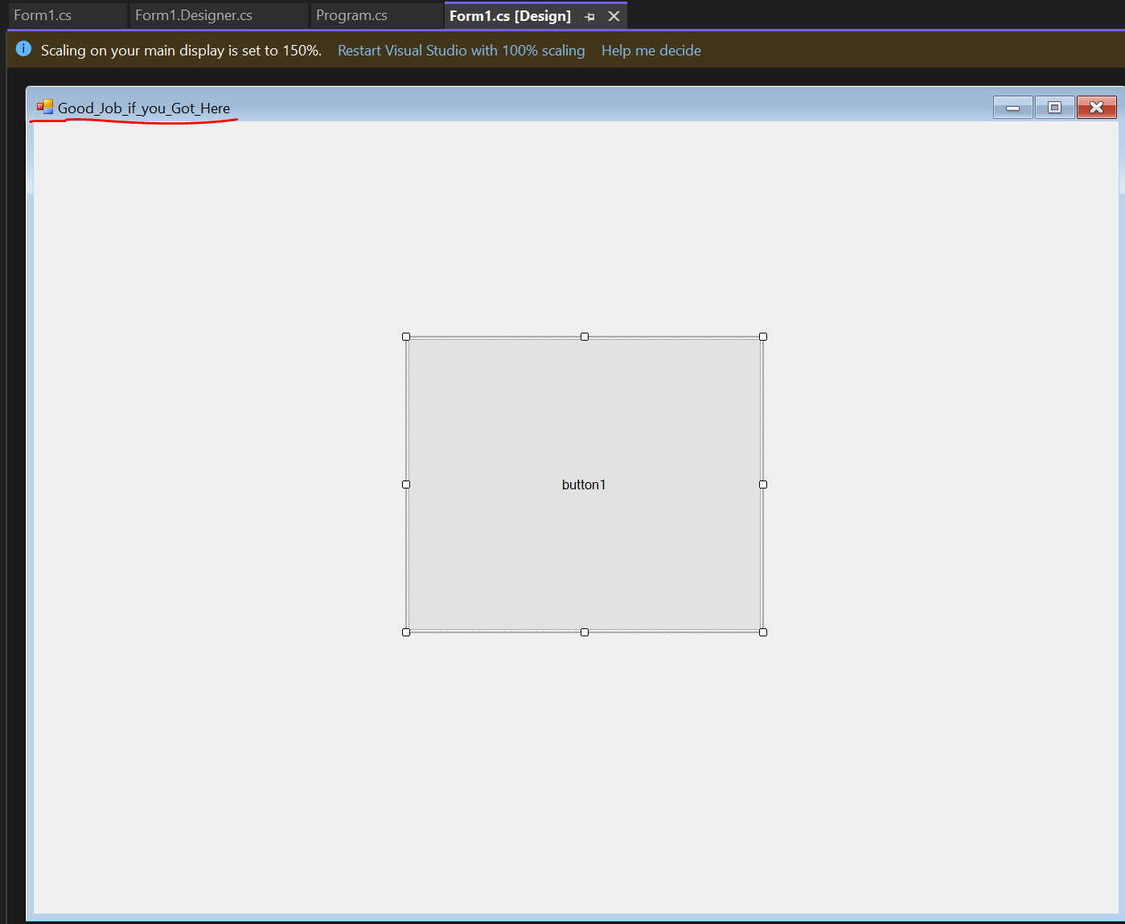

Slide 10
Man my eyes hurts what's a solution
Complaints:
1: Dislike Background color/change to specifically (75, 30, 100) RGB
2: Dislikes default Text of buttons text (wants it to say CUSTOM BUTTON)
3: not enough buttons add 1 more
4:challenge for those who go home -Final Slide
How can we go about this?

Slide 11
For those who said toolbox
That is a fine answer especially for any programmer as it’s a tool in the system.
However unfortunately a lot of dev environments you work in will break by either your fault or someone else so let's think 1 level deeper
(and) it’s possible that the Dev environment your in does not have the toolbox feature implemented
Afterall as Software engineers we should aspire to be as low level as possible, after all the billion dollar corporation pays us to make the flat rock do things for them

Slide 13
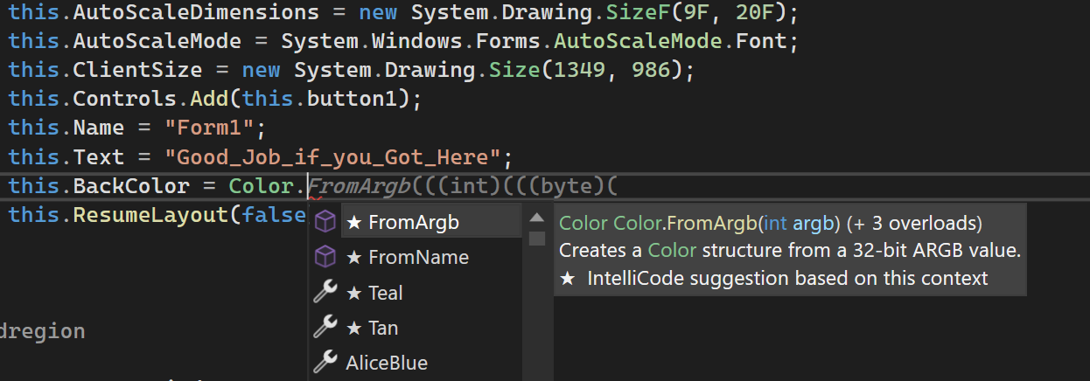
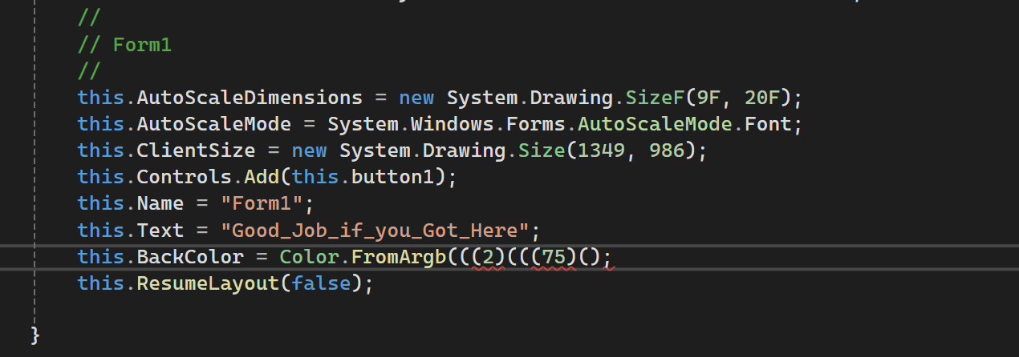

Slide 14
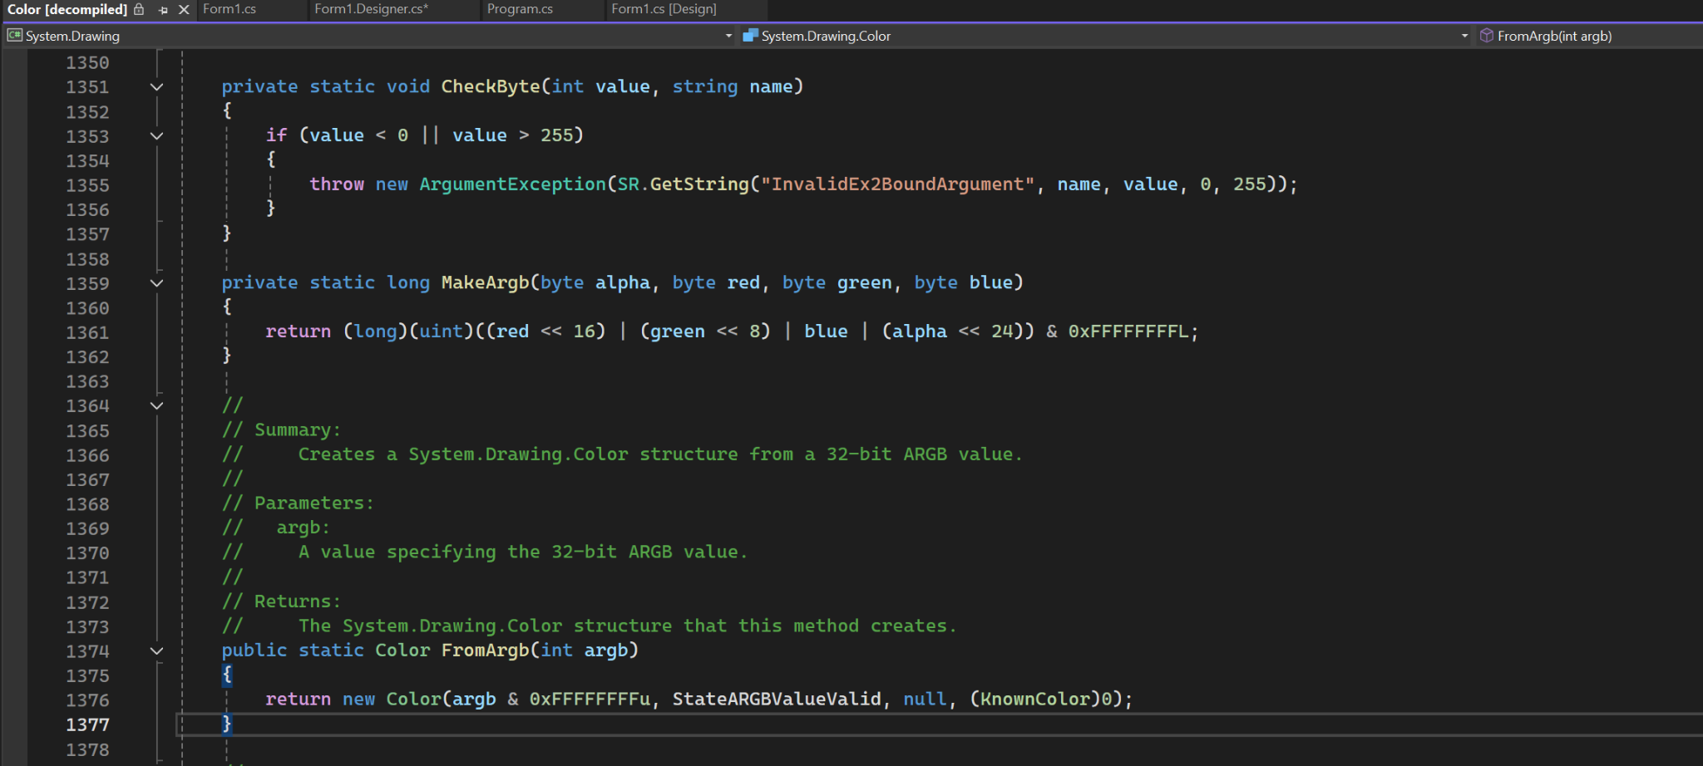
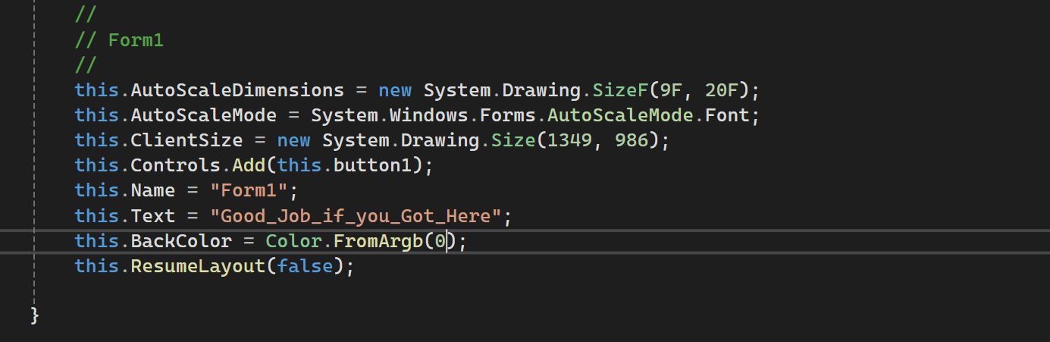
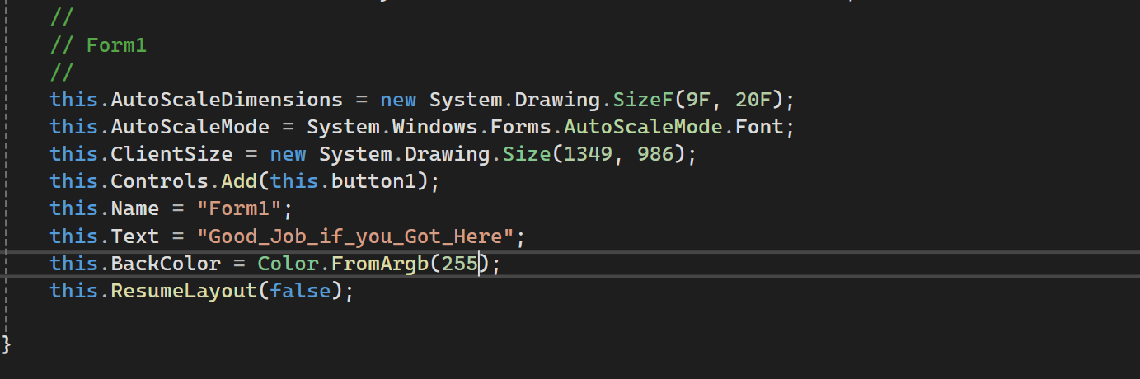
How to solve problems like a programmer
Step 1: Check function by holding ctrl click ex =>
1 argument
Step 2: test to see if what you want works
Step 3: :D no errors lets go to the next slide

Slide 15
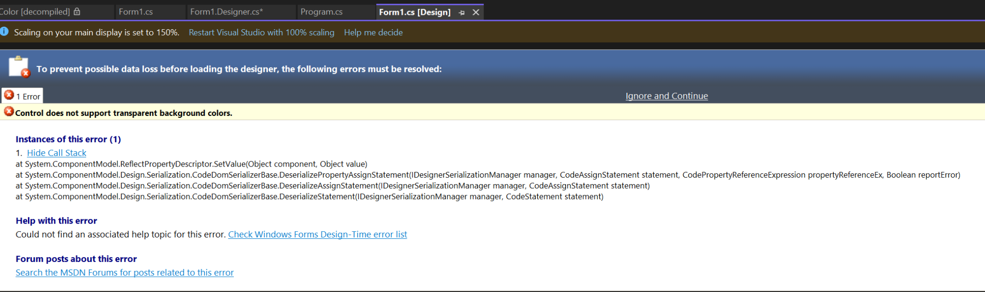
Reality
So we have a issue ^^^ How should we fix this =>(you guys give ideas)

Slide 16
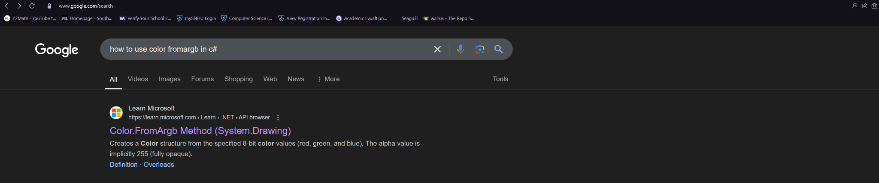
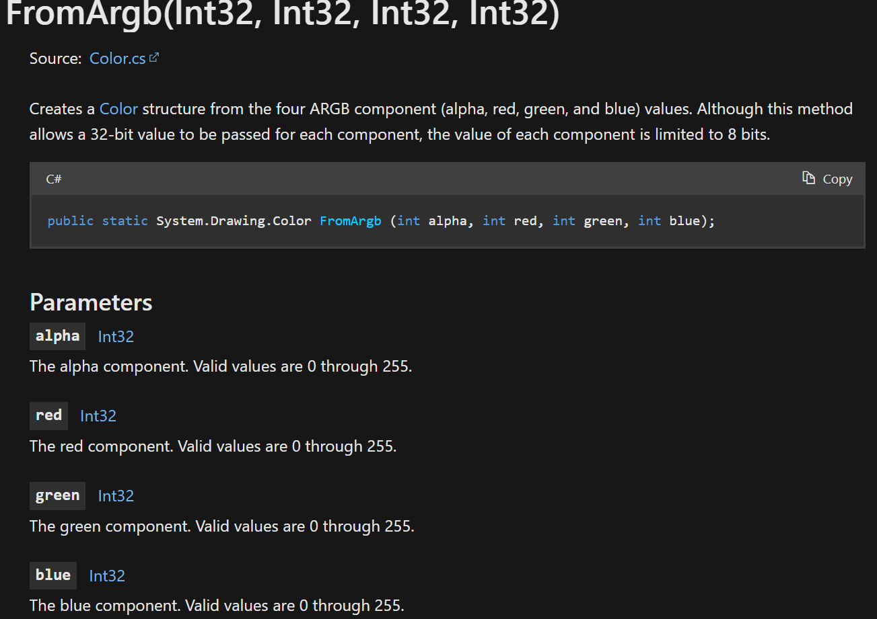

The Internet solution: any other ideas (if you haven’t given others)
Hint =>
File from this

Slide 17
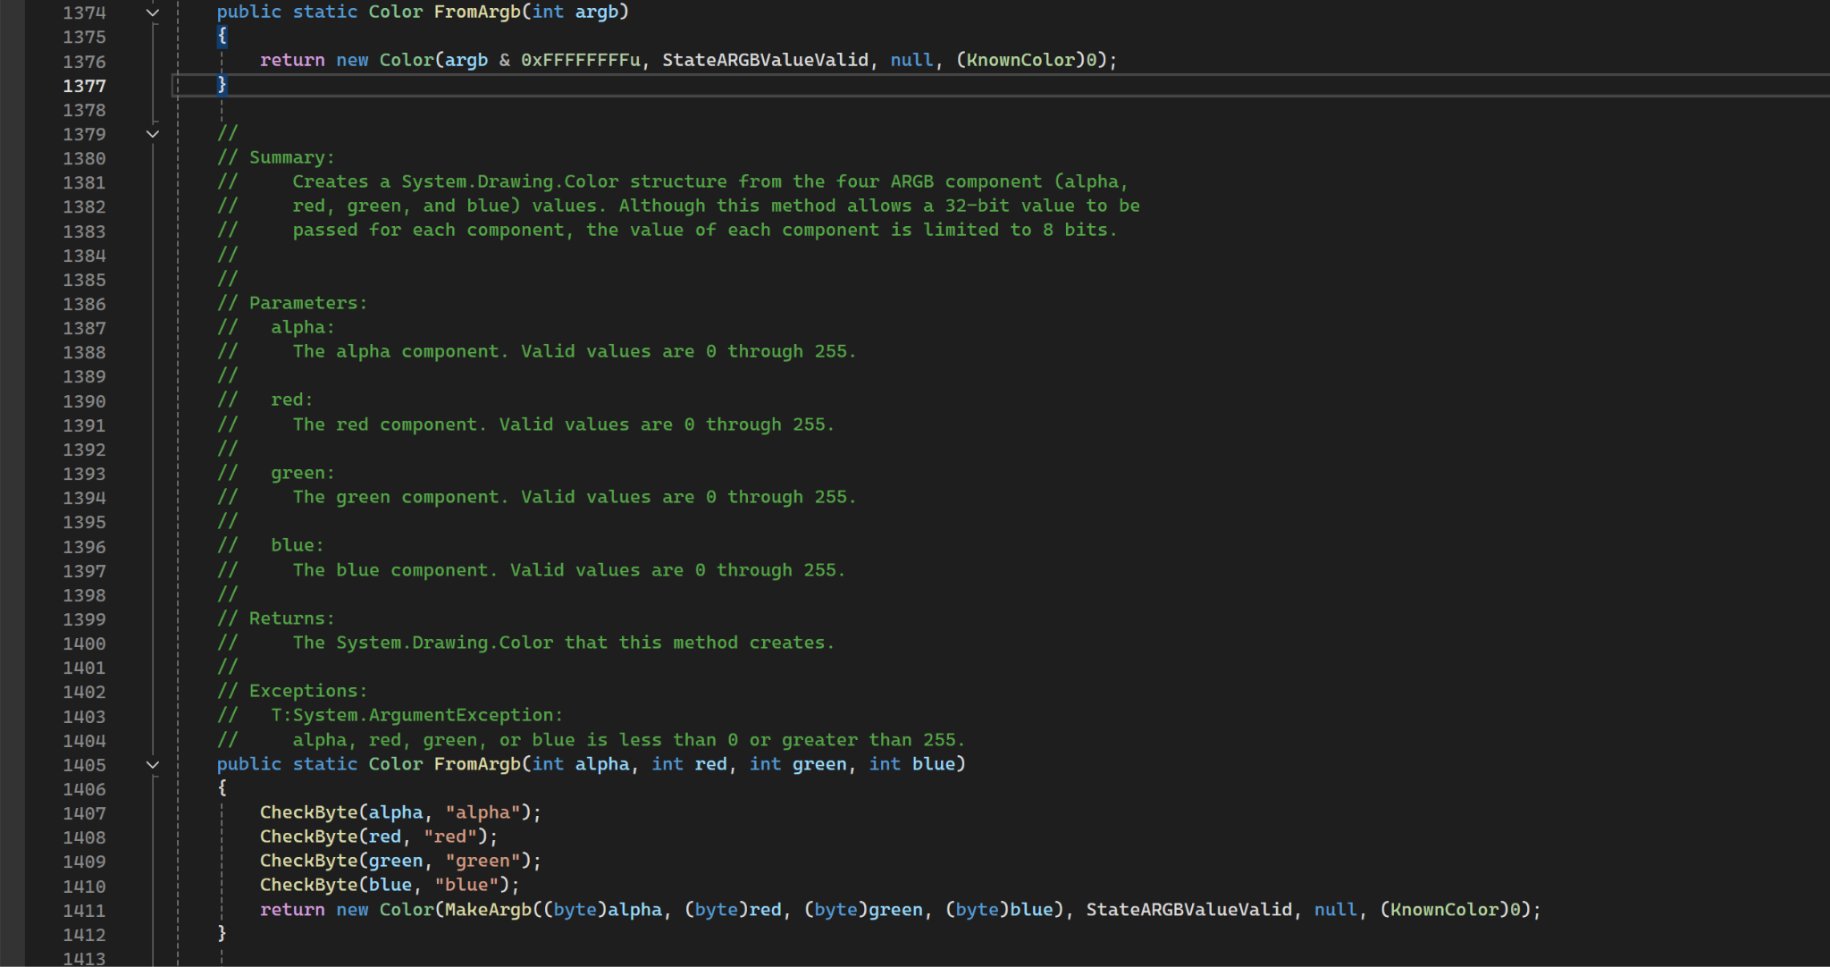
Welcome to Overloaded Functions
Or decomplied errors don't ask me idk
What is a overloaded function => (you guys answer)

Slide 18
So let’s test this value
Take a guess at what color we are going to get

Slide 19
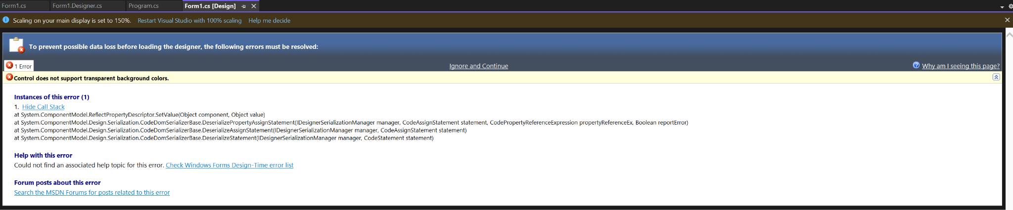
Reality Once again
Secret for us to solve
If i have not talked about call stacks errors it’s time
A very short version
Main error Control does not support transparent
And in the call stack The first and second line we see
A Error
So as programmers what can we do to figure out this solution => (take guesses)
Errors we see:
ReflectProperty.Set…
PropertyAssignStatment(Boolean Report error)

Slide 20
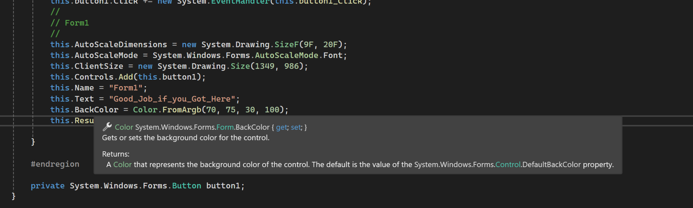
Thats Right lets to go to the class that we are trying to change
We head to the Form Class

Slide 21
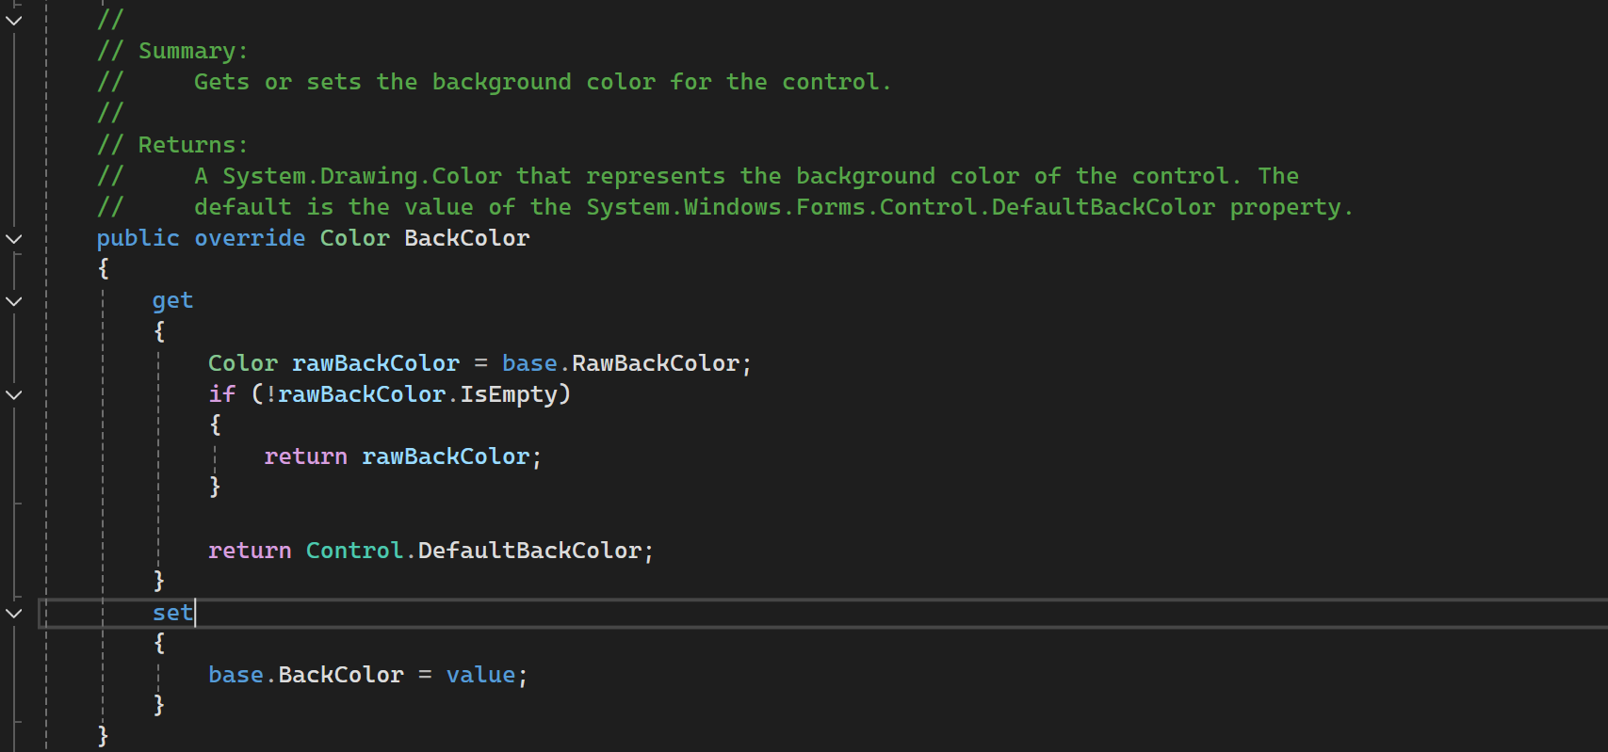
Not Seeing anything strange that should break it, => (any thoughts)
Professor ⇐(if you want) to say the kind of issue on this
Form1 : Form -> Form : ContainerControl -> ContainerControl : ScrollableControl -> ScrollableControl : Control

Slide 22
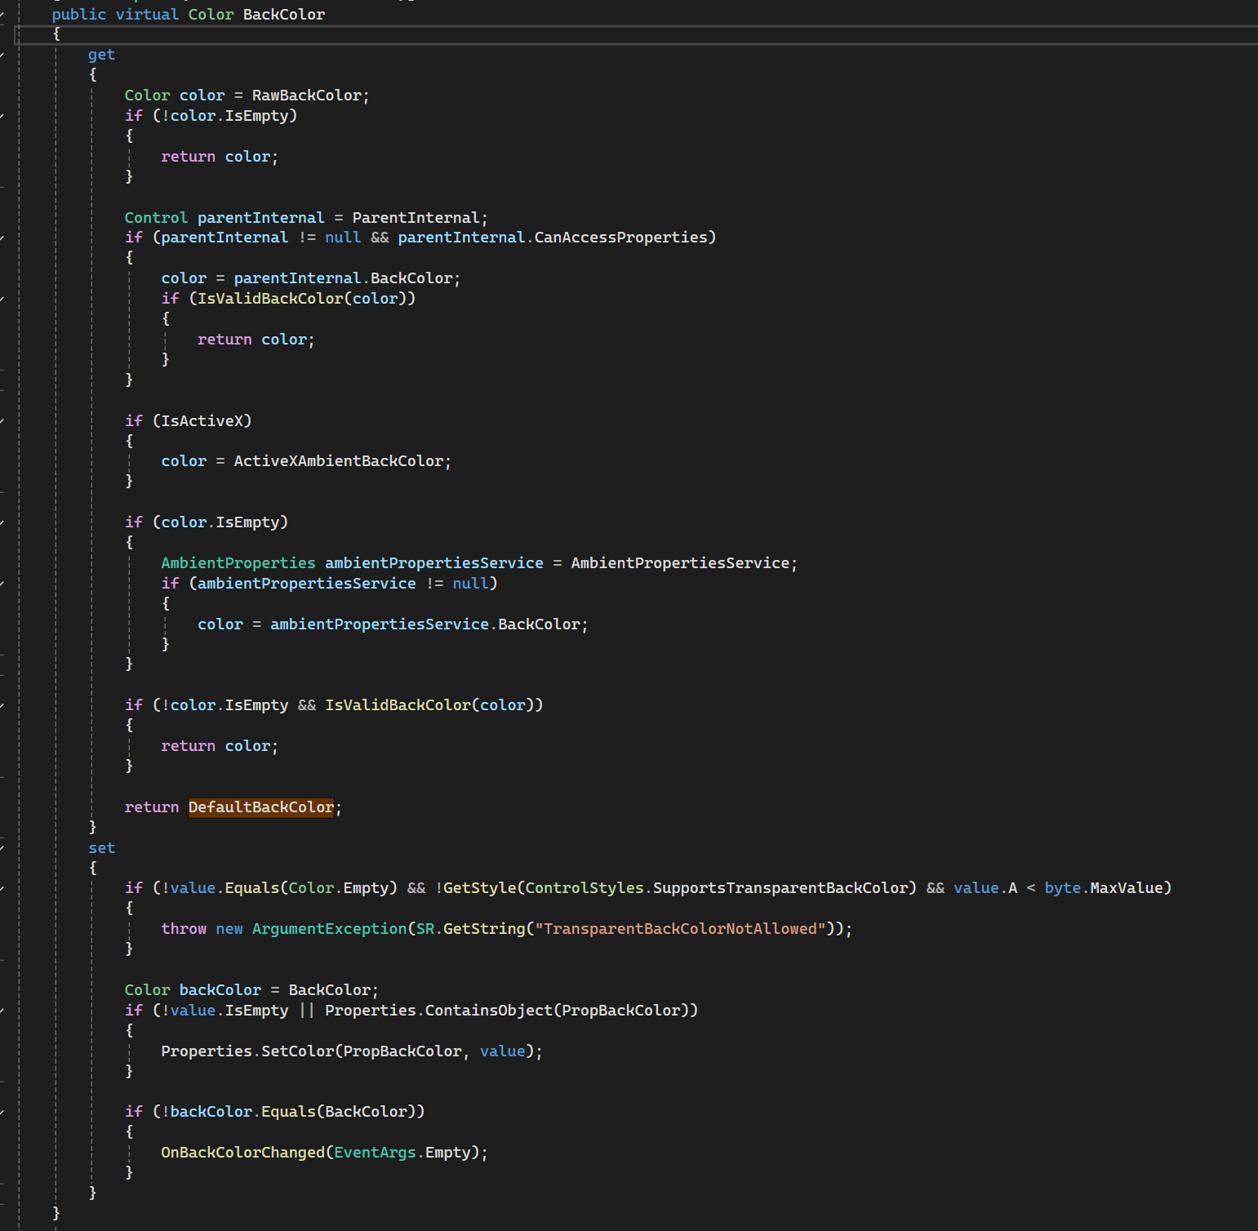
Inheritance issue
In this case we have a easy way to navigate to the code so we look in what control is doing with this variable
1: NOTICE the Virtual Keyword
2:come back to this slide once we talk about overriding
3: as we can see clearly IsValidBackColor() is a interesting function lets look (2 slides down)

Slide 23
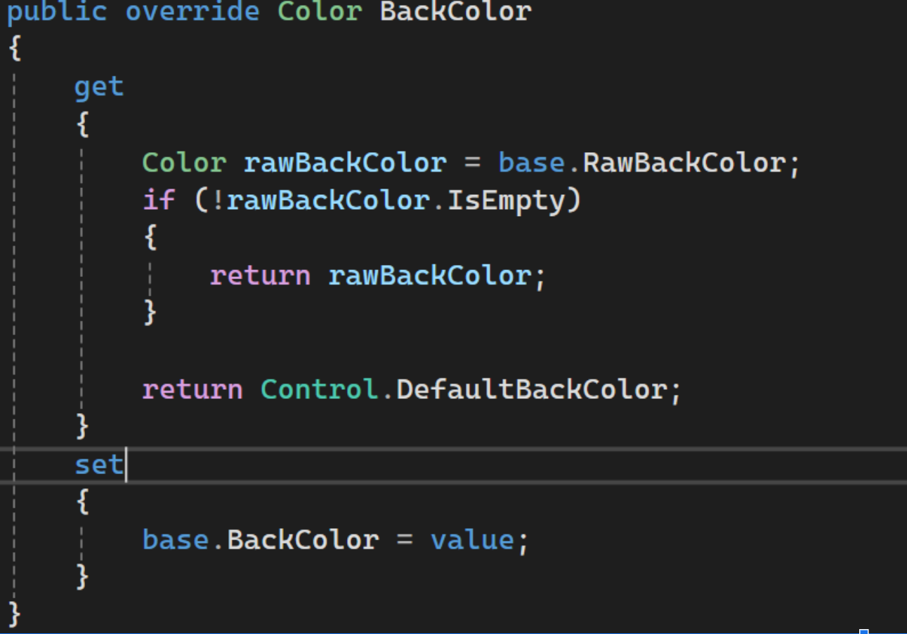
Anyone?
1: virtual means this class inside of Control can be implemented and changed IF a class implements this it Will completely overwrite the code SO why are we looking here

Slide 24
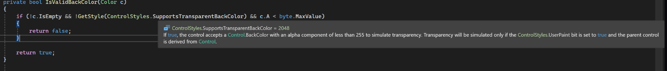
As we see Control does not allow Transparency and we figured it out ourselves with a bit of stack reading + going into classes
Since we know this let’s go find our transparency argument

Slide 25
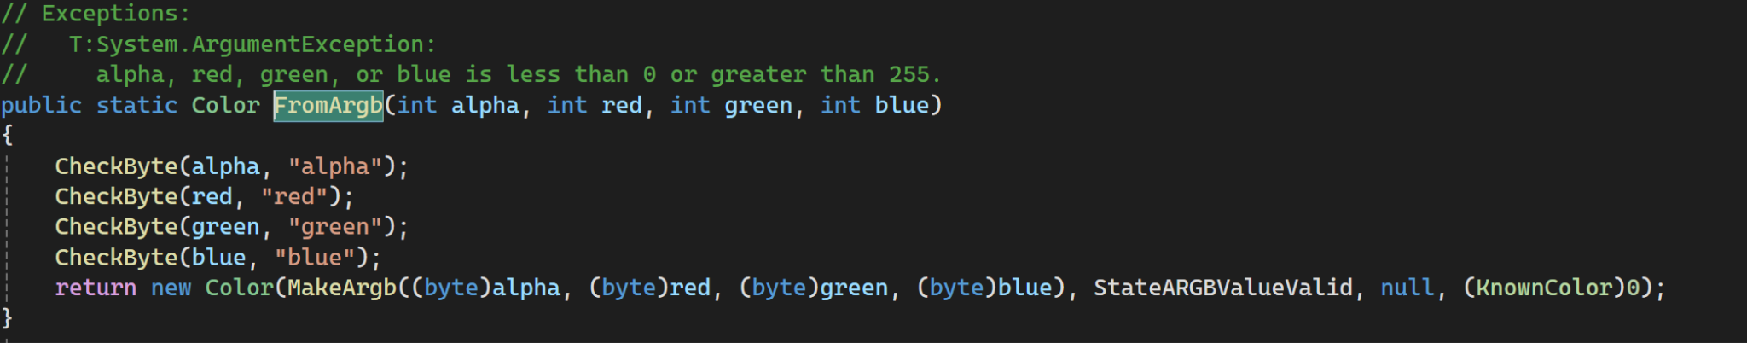
So here is our issue 70 must not be a valid value as it is in between the two min and max value so
Lets try the max value as typically In terms Of ALPHA and not Transparency the higher the Alpha the Less Transparency

Slide 26
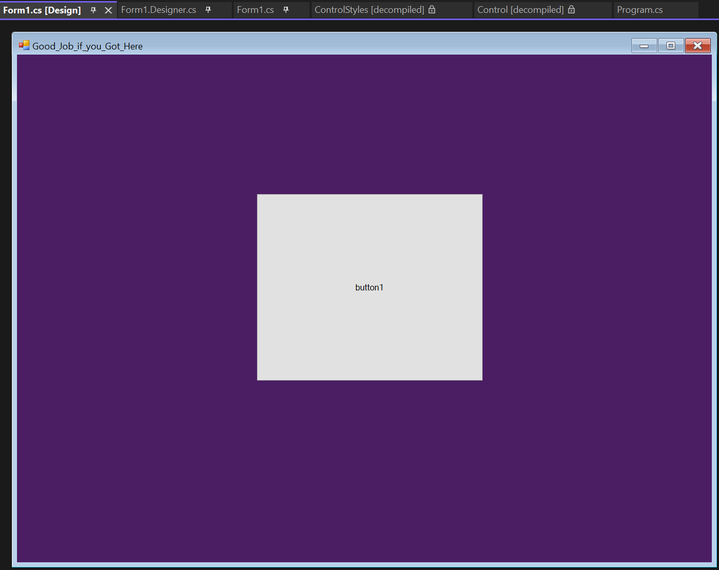
Fantastic we just completed a clients request this sort of problem solving is INCREDIBLY important for software engineering and as you code more this will take you mere seconds/minutes to solve these errors

Slide 27
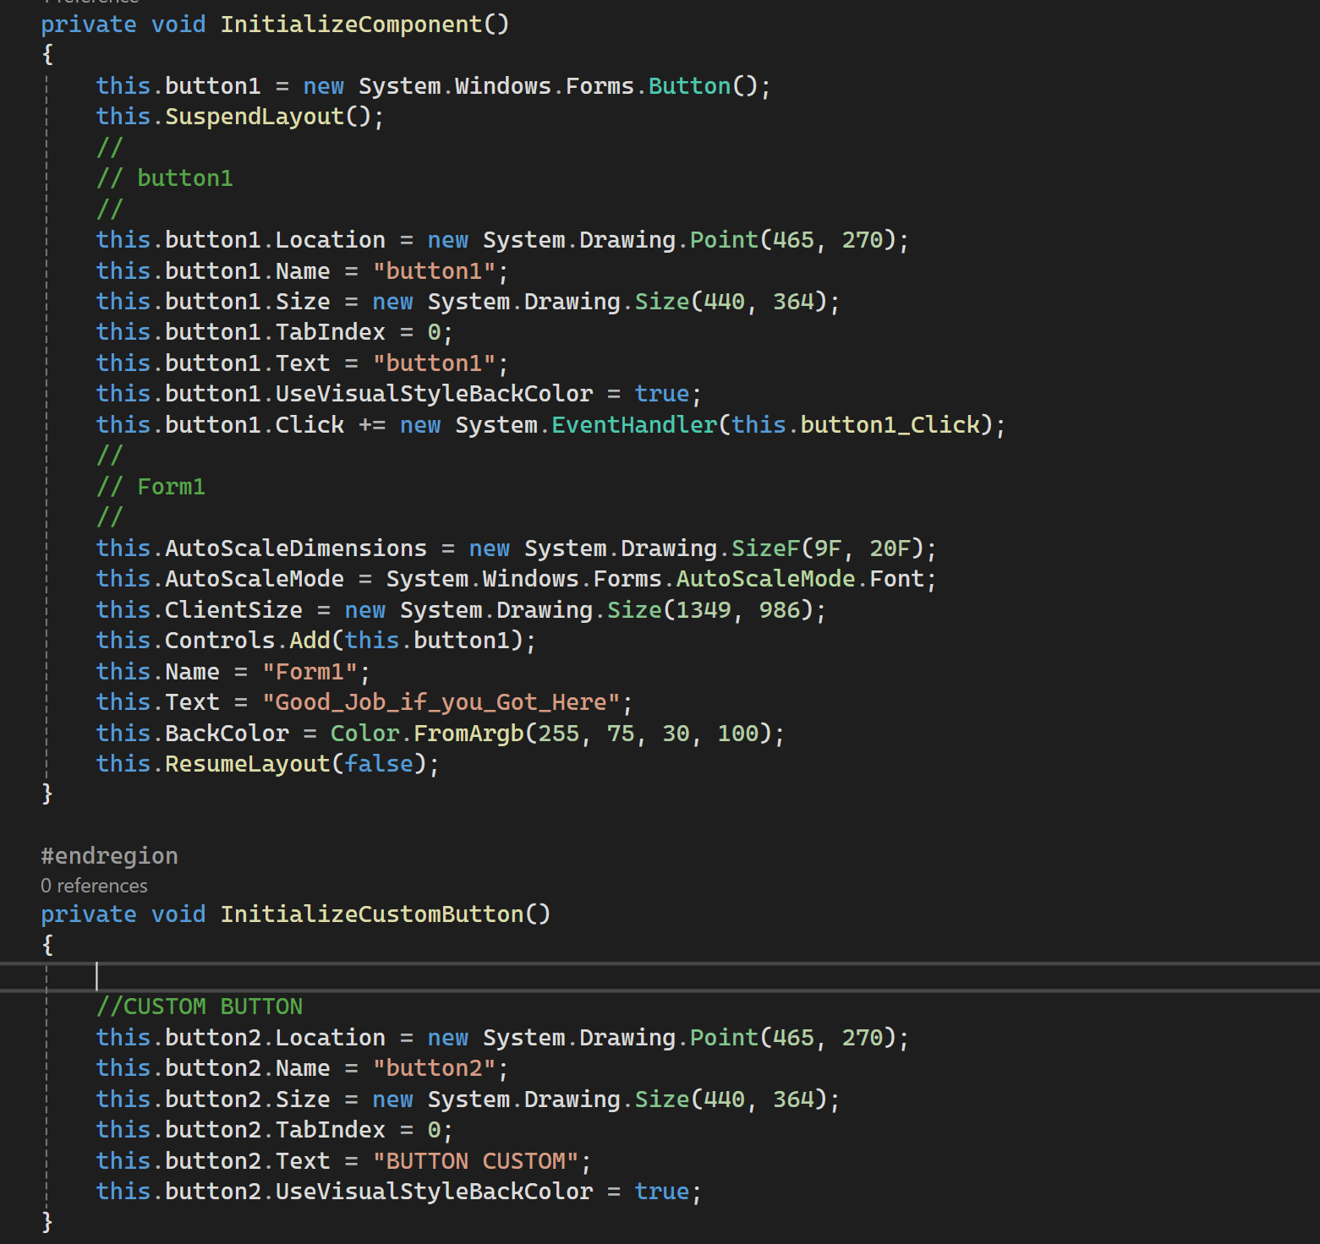
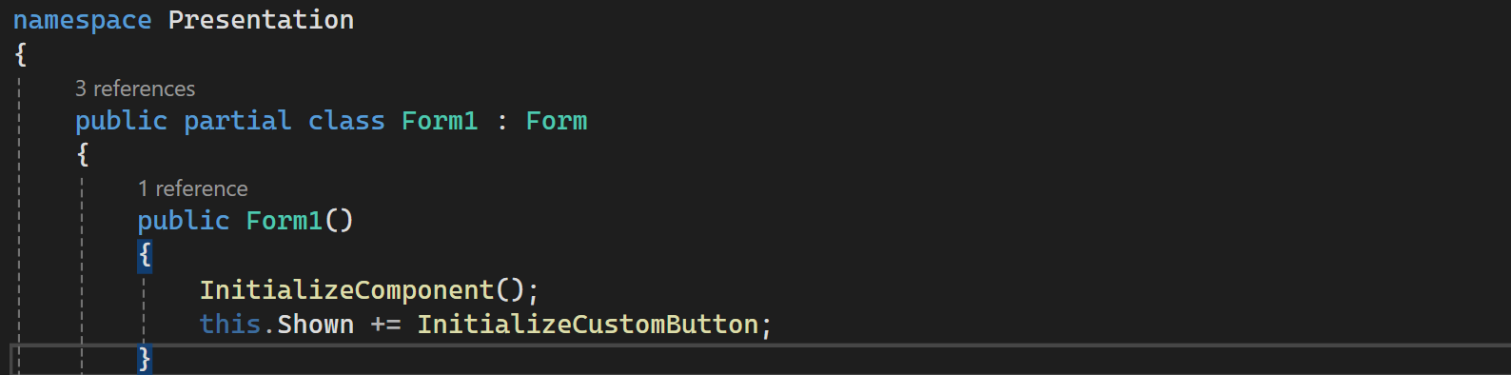
Let’s add that custom button
Now this might be a bit overwhelming so let’s take it in steps that are easy we need to:
Create a function where we will initialize it in the constructor so

Slide 28
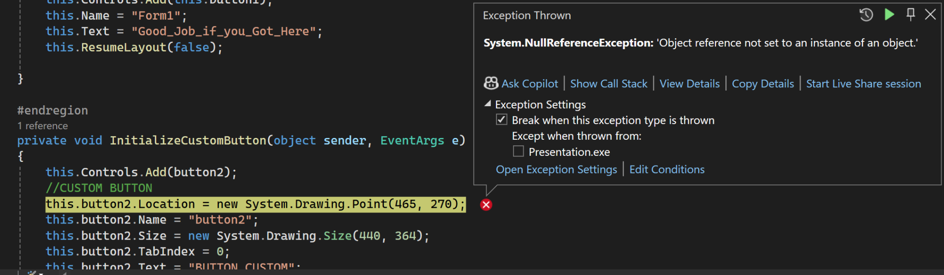
Ok so we got a error
This error is pretty cut in dry any ideas =>

Slide 29
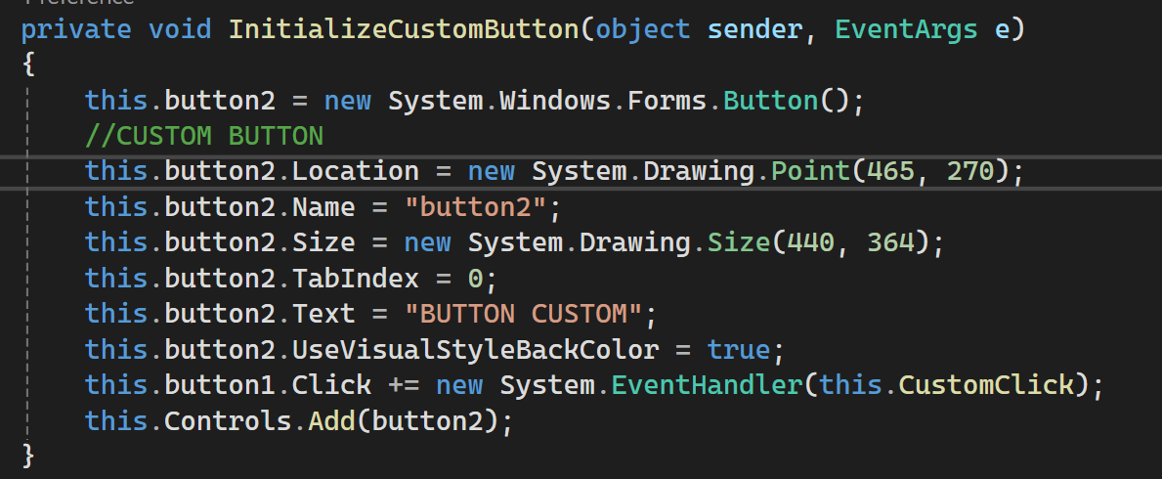
The error was the lack of a object aka this.button2 = new…

Slide 30
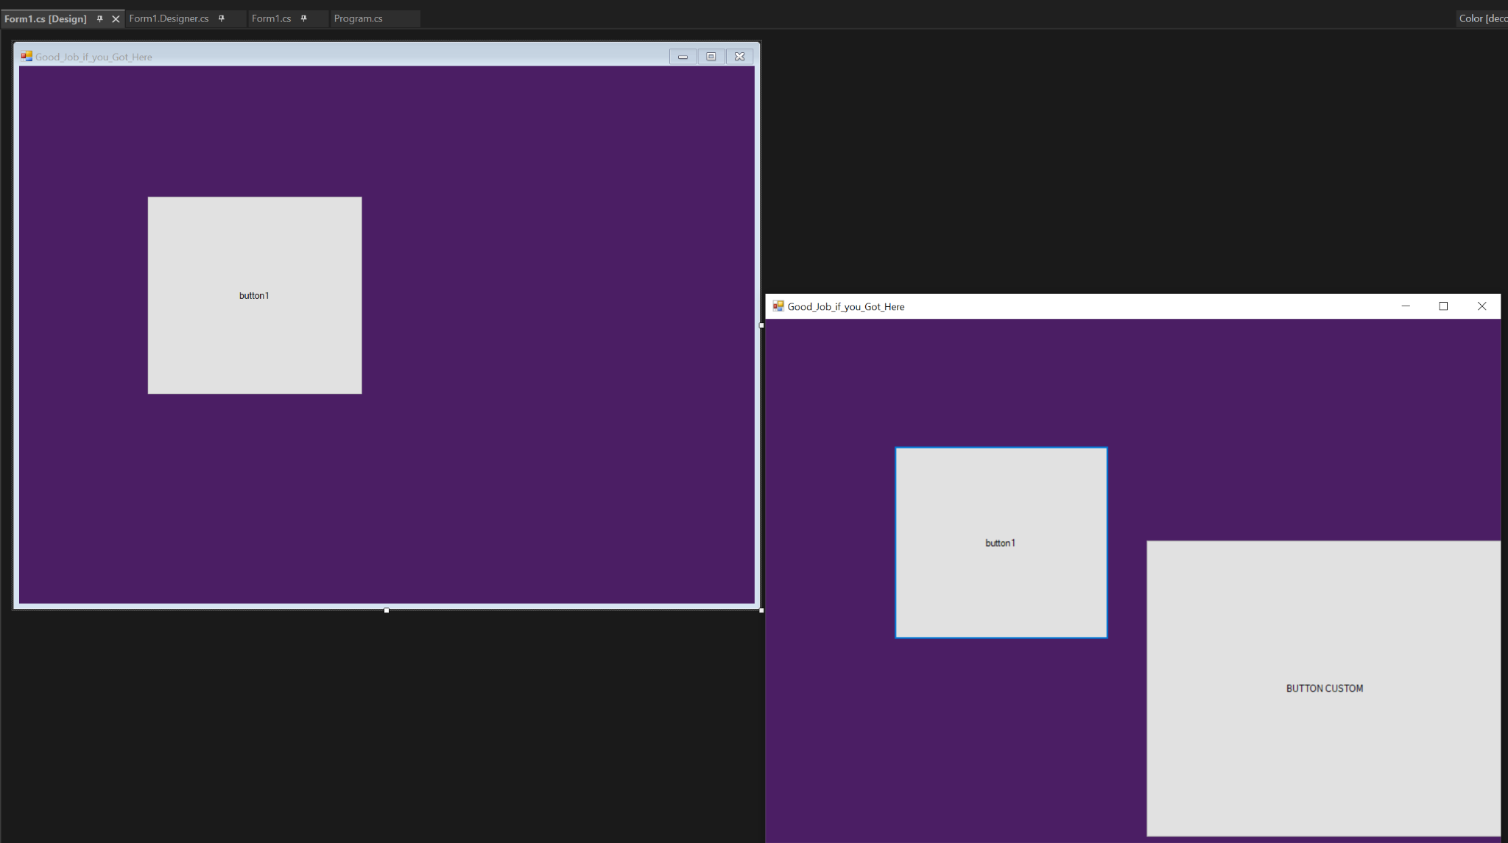
With this error corrected let’s look at what we got
Now we see the button is not in the design menu and that could be annoying so lets take advantage of the C# powers like so

Slide 31
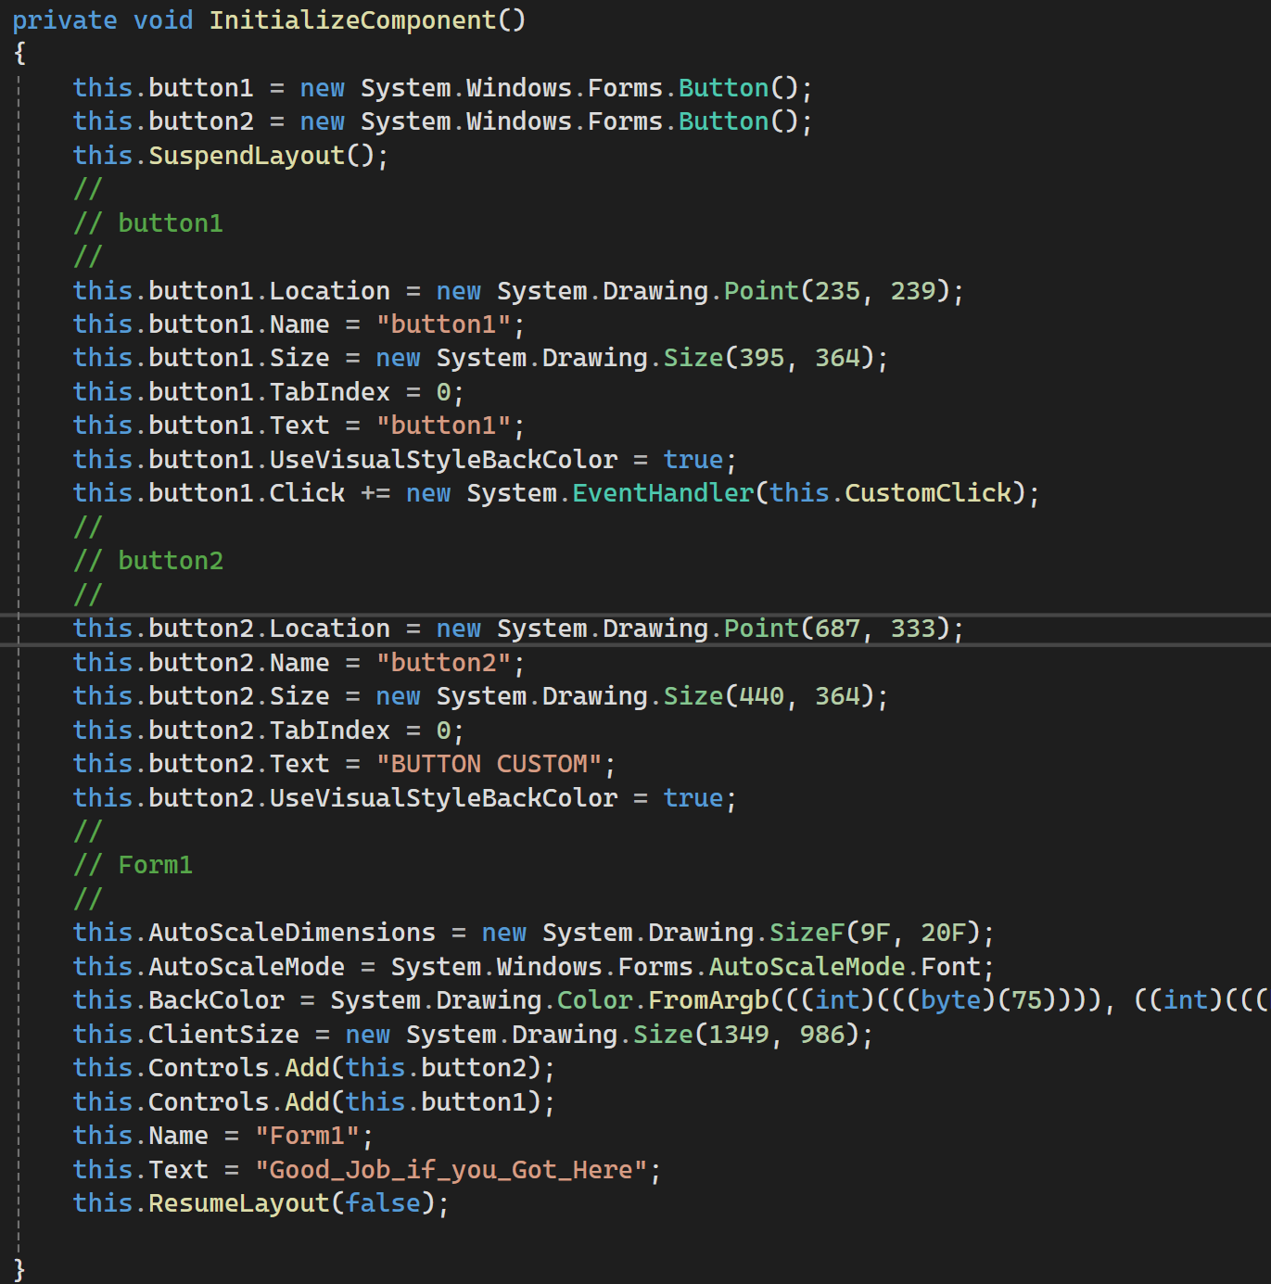
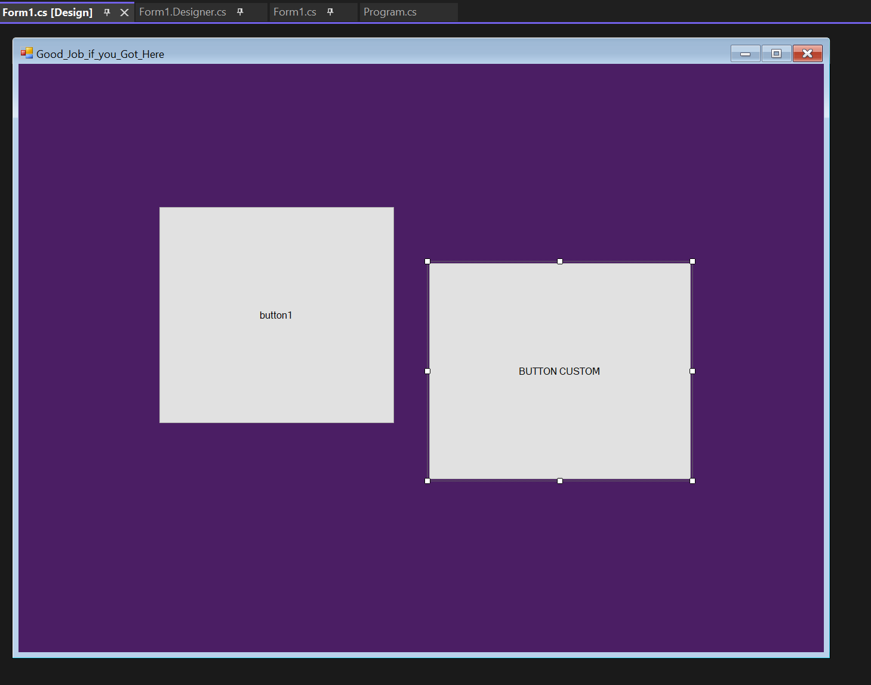
As you can see we have the ability to see it in the design menu and even move it around, as for the last 2 slides i will justify:
It is important to understand how to add components into your program not just using the provided functions as it increases one’s understanding of the framework,

Slide 32
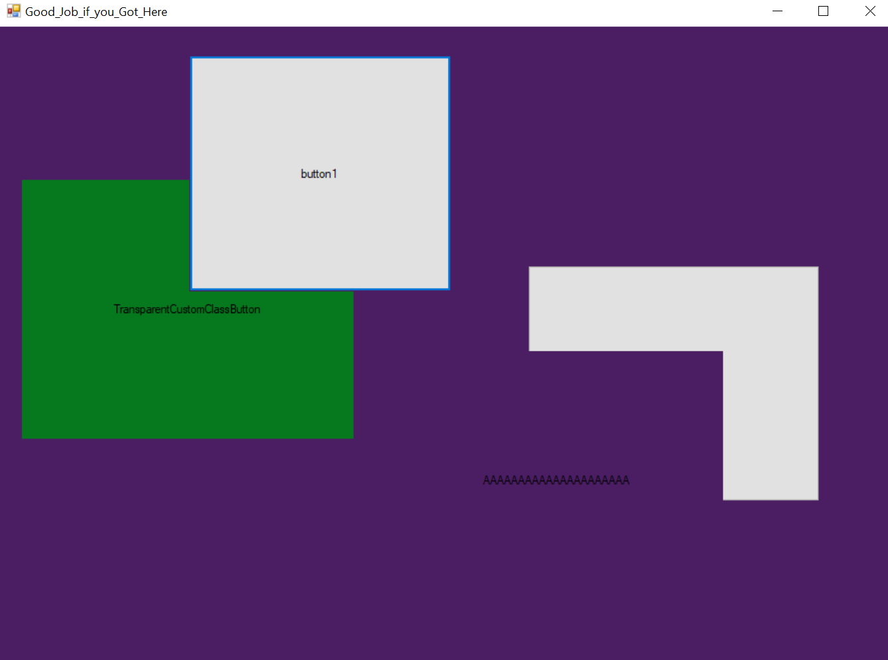
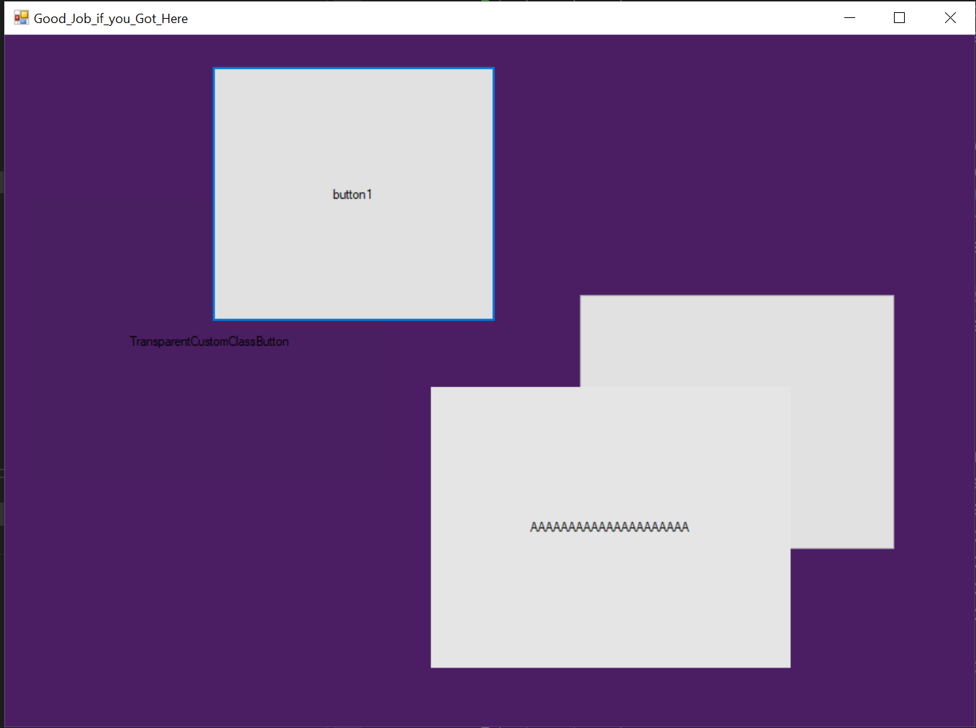
Final Slide Challenge: for those who want to challenge there debugging
What if the Customer demanded that
The Main window HAD to be Invisible as transparency is incredibly hard to do in Winformapp as it’s not a supported function

